Slide 1

Explore Outdoors
Relax, Refresh, Rejuvenate
Brielle McCormick Tatyana Khan Heribert Villazana Daria Tharmaratnam Margaret Seiche

Slide 2
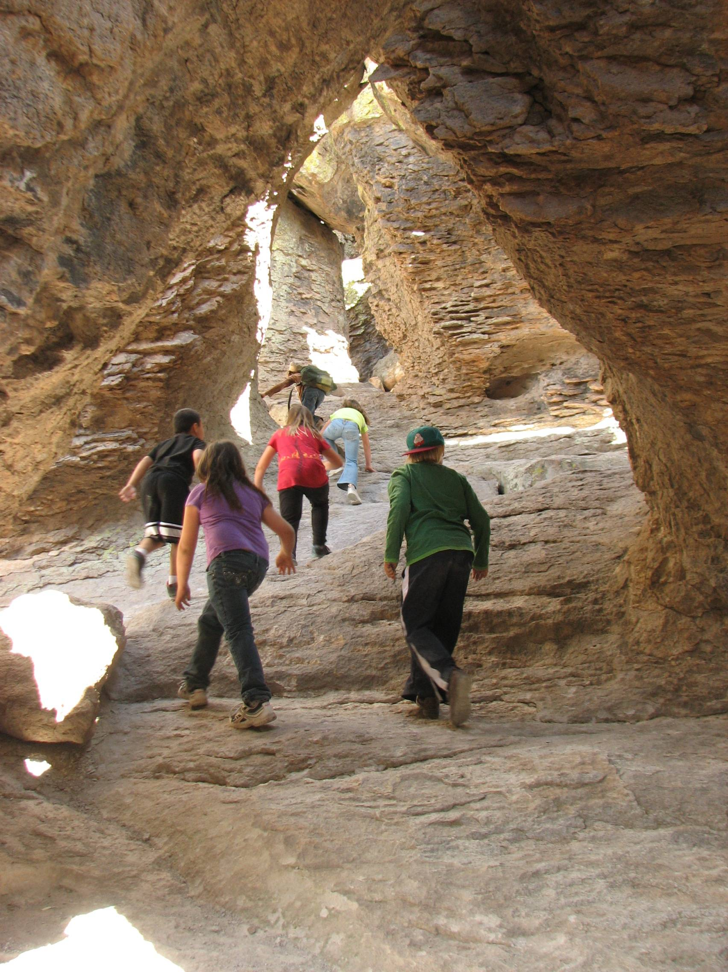
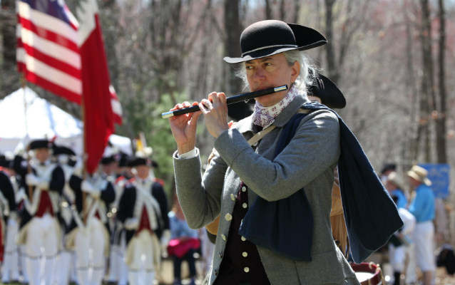
Elevator pitch
After a tough week, in front of a computer, at the office, or at home,
who doesn’t want to relax?
We created a day planner app to help.

Slide 3
Concept
Issue: | In the midst of Covid-19, working from home, summer heat and school breaks have people looking for safe and creative ways to have fun.
Solution: | The outdoors has a lower transmission risk and helps separate the newly blurred lines of work and home.
Goal: | Create a day trip planner linked to the 400+ National Parks with a user-friendly interface. Allow users to locate all parks within their state. User can refine their search by filtering through themes and activities. Link location and local weather information to produce a seamless planning experience.

Slide 4
Process
Technologies used:
Adobe Illustrator, Pure CSS, JQuery, National Parks API, OpenWeatherMap API, Leaflet API
Breakdown of tasks and roles: Break down by page but everyone helped
Brielle: Designed wireframe and user-interface, styled website with semantic HTML and CSS, created presentation
Heribert: Linked weather API and built weather block, assisted in site styling, created readME file, and conducted troubleshooting
Margaret: Created initial index and search page HTML, wrote Javascript for park section of details page
Tatyana: Created initial details page, wrote Javascript for search and results pages, troubleshooting
Daria: Connected Javascript from results to details page, linked map API and built map section, troubleshooting search and results
Successes
Displaying information correctly,
Working as a team,
Learning new GitHub skills
Challenges
Learning to merge code (technical GitHub),
Communication of ideas,
Picking which map API to use,
Using state abbreviations to access details we need,
Bug in title entrance fee object on National park API,
Not filtering results before submit button)

Slide 5
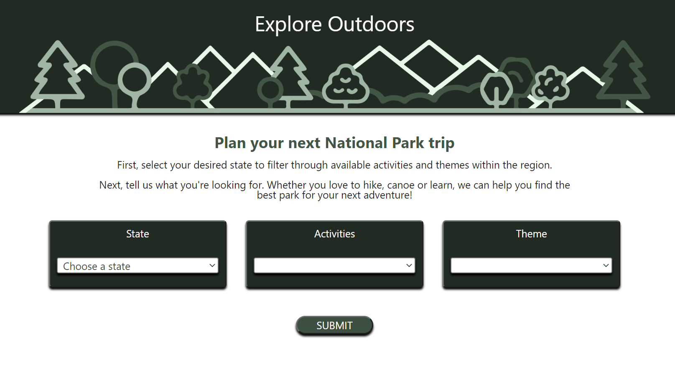
Demo

Slide 6
Directions for Future Development
Future versions:
Linked transit options
Local restaurants within the area
Allow additional filtering capabilities such as level of difficulty, amenities, and duration of stay
Update user-interface to feature modal popups
Add slideshow to details photos

Slide 7
Links
Deployed: https://khantatyana.github.io/Project-1/
GitHub repo: https://github.com/khantatyana/Project-1

